Slide 1
Sprint 9 Demo
Tuesday, August 23rd , 2022

Slide 2



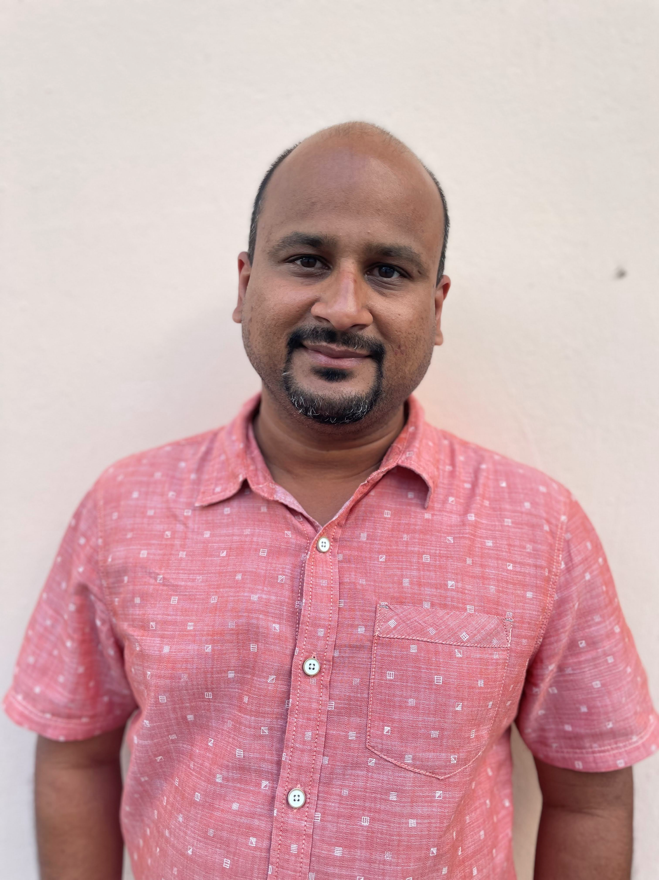




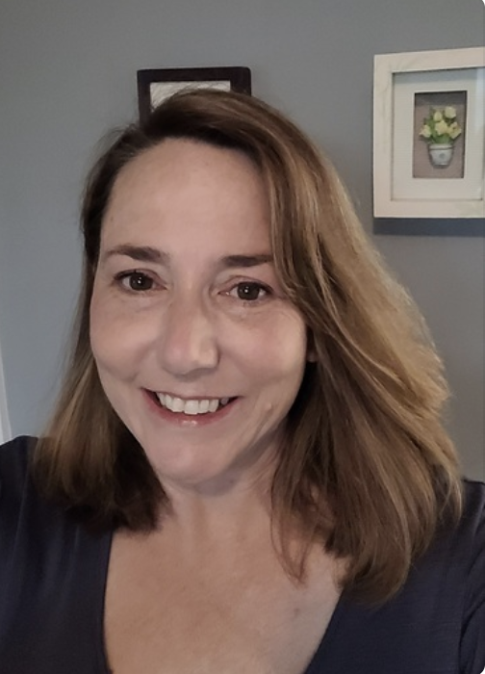





Get to know the team
Core team
Executive team
PRODUCT
DESIGN
ENGINEERING
Jeanette Cantrell
Chantilly, VA
Product Lead
Thomas McCue Oak Park, IL Principal Designer
Deb Dennis Oakland Hills, CA UX Researcher
Health Hub only
Shashank
Khandelwal
Rockville, MD
Tech Lead
Teagan
Stephenson
Ft. Lauderdale, Fl
Full Stack Engineer
Jeff Scheire
MO Studio
Marcy Jacobs
McKinsey & Co
Kevin London Frog Design
Tami Corson
New Bern, NC
Clinical SME / Scrum
Carl Dickerson Atlanta, GA Content Strategist and Plain Language Content Creator
Carolyn Williams Chicago, IL Experience Designer
Dan Smith
Charleston, SC
QA Engineer / 508 Specialist
Will Reynolds SERVE Advisory
Ben Morris
Pluribus Digital
08-23 Sprint 9 Demo
Introduction

Slide 3



At the end of each sprint on Tuesdays, the team will run sprint reviews to showcase the sprint’s work for approval. The purpose of this meeting is:
WELCOME TO THE SPRINT 9 DEMO
1
To demo the accomplishments or functionality that was built over the past sprint
2
To get feedback and insights early and often
3
To create transparency for anyone interested on the product and progress
08-23 Sprint 9 Demo
Introduction

Slide 4
CEDAR TO1 Overview
WE ARE HERE
CY 2021
CY 2022
PHASE
SPRINT
0
1
2
3
4
5
6
7
8
9
10
11
12
13
14
15
16
17
18
19
20
21
22
23
24
25
MONTH
Sep
Oct
Nov
Dec
Jan
Feb
Mar
Apr
May
Jun
Jul
Aug
Sep
DHM - Health Apartment
FOCUS
1095-B Form
Community Care
Health Hub
08-23 Sprint 9 Demo
Introduction

Slide 5
Agenda
HEALTH HUB
Sprint Goal:
For sprint 9 we conducted moderated tests of Health Hub IA trees, continued collaboration for 1095-B staging review and MVP launch preparation, and drafted transition documents as part of contract close-out.
Research Phase 2: Moderated testing of IA trees
1095-B
Testing approach and progress
Feature toggle with UX in mind
Business owner brief
Other updates
TURNOVER PLAN
Close out plan
Transition of ownership
 | We welcome all feedback! Feedback will be collectively reviewed and prioritized appropriately based on where it stacks against other stories in the backlog as well as technical feasibility.
08-23 Sprint 9 Demo
Agenda

Slide 6
Health Hub
SPRINT 9 DEMO
08-23 Sprint 9 Demo

Slide 7



Health Hub Workplan v9
Owned by product team
WE ARE HERE
SPRINT 1
4/20 – 5/03
SPRINT 2
5/04 – 5/17
SPRINT 3
5/18 – 5/31
SPRINT 4
6/01 – 6 /14
SPRINT 5
6/15 – 6/28
SPRINT 6
6/29 – 7/12
SPRINT 7
7/13 – 7/26
SPRINT 8
7/27 – 8/09
SPRINT 9
8/10 – 8/23
SPRINT 10
8/24 – 9/6
Kickoff
Discovery
Build Roadmap
Product & Delivery
Build initial workplan and backlog
Business partner discovery
Moderated IA treejack Research
Moderated IA treejack interviews & synthesis
User Experience & Design
Comparative research
Consolidate existing research
Experience Map
Current state mapping
Research Activities Plan (RAP)
IA Tree Test Plan H0 & H1
Final IA Recommendations delivered
Engineering & Development
Tech Discovery
08-23 Sprint 9 Demo
Workplan

Slide 8
A
Research phase 2: Completed Interviews
User Story: Discussed recruitment with Perigean
User Story: Conduct pilot test of research #2
User Story: Begin moderated research #2
User Story: Draft synthesis modeling for moderated research
Cohort # | Studies Completed
Cohort 1 Hypothesis 0 - Veterans with health care | 5
Cohort 2 Hypothesis 1 - Veterans with health care | 5
Cohort 3 Hypothesis 0 - Veterans eligible without health care | 1
Cohort 4 Hypothesis 1 - Veterans eligible without health care | 1
Recruiting
To date, a total of twelve completed studies
5 H0, 5H1, all enrolled in VA Health Care benefits
1 H0, 1H1 not enrolled in VA Health Care benefits (but eligible)
14 remaining participants without health care, but eligible
Once cohorts 3 and 4 are filled (5 participants each), any remaining participants will be cancelled
08-09 Sprint 8 Demo
Health Hub
8

Slide 9
Research phase 2: Moderated testing of IA trees
A Selection of User Quotes
"How to Pay your bill. I'm sure this is where I pay it. I would probably write it as, Pay Your Bill Here."
"Once I'm eligible, then I can just be focused on my Health Care. Makes sense to me to have Admin stuff separate from MyHealth."
"Enroll in VA Health Care. You want this link upfront, first you get me established in the system and then ask what type of services do I need? My Medicare account setup did this process."
"Wasn't hard, but wasn't easy, cause we have vets who aren't good on computers."
"So if it says MYHealth I'm going to assume it pertains to ME, I don't think I want the other info under that."
User Story: Discussed recruitment with Perigean
User Story: Conduct pilot test of research #2
User Story: Begin moderated research #2
User Story: Draft synthesis modeling for moderated research
Mural, research plan & conversation guide
08-09 Sprint 8 Demo
Health Hub
9

Slide 10
1095-B
SPRINT 9 DEMO
08-23 Sprint 9 Demo

Slide 11

1095-B Workplan v9
Collab cycle tollgates
Release
WE ARE HERE
SPRINT 7
4/20 – 5/03
SPRINT 8
5/04 – 5/17
SPRINT 9
5/18 – 5/31
SPRINT 10
6/01 – 6/14
SPRINT 11
6/15 – 6/28
SPRINT 13
6/29 – 7/12
SPRINT 14
7/13 – 7/26
SPRINT 15
7/27 – 8/09
SPRINT 16
8/10 – 8/23
SPRINT 17
8/24 – 9/6
1095-B: Spanish translation docs
Turnover document of remaining post-MVP work (VA notify, 2022 IRS form, 508 compliance, multiple year selection)
1095-B: Legal Review
1095-B: Legal Review – Opt-in
Product & Delivery
VA 508 Assistance request
MVP 508 Spanish translation docs
Kickoff
Align on launch MVP v. MVP w/ opt-in
Design for opt-in
User Experience & Design
Notification flow
Design for MVP 508 accessibility
Build for accessible MVP
Engineering & Development
Plan for and facilitate post MVP opt-in
Build for Analytics
Collaboration Cycle
Sitewide and Content IA ticket opt-in
Call center review
Analytics & QA
MVP staging review
1095-B Post launch evaluation
Security &
privacy review
MVP launch
Go Live
08-23 Sprint 9 Demo
Workplan
11

Slide 12
A
Testing approach and progress for 1095-B
User Story: Ensure ES writes script to load 1095-B data file
Testing the 2021 data load
We received all of the 2021 data (to be able to generate 1095-B forms). We are in the process of testing and debugging the data load
Sample dataset we received previously (70 records) was not representative
It’s a slow process since we can’t view the data files (they have PII) and the script runs daily at 3am ET
We’re adding more logging for better information during the data loads
Testing the 1095-B page + React widget in staging
The sitewide public team is building an EntityQueue module that will allow the page to be built in staging but not in production
Github ticket
We have pushed staging review to allow this work to finish (and allow us to test)
Accessibility
We re-tested accessibility on the text-based form based on characters with diacritical marks
08-23 Sprint 9 Demo
1095-B
12

Slide 13
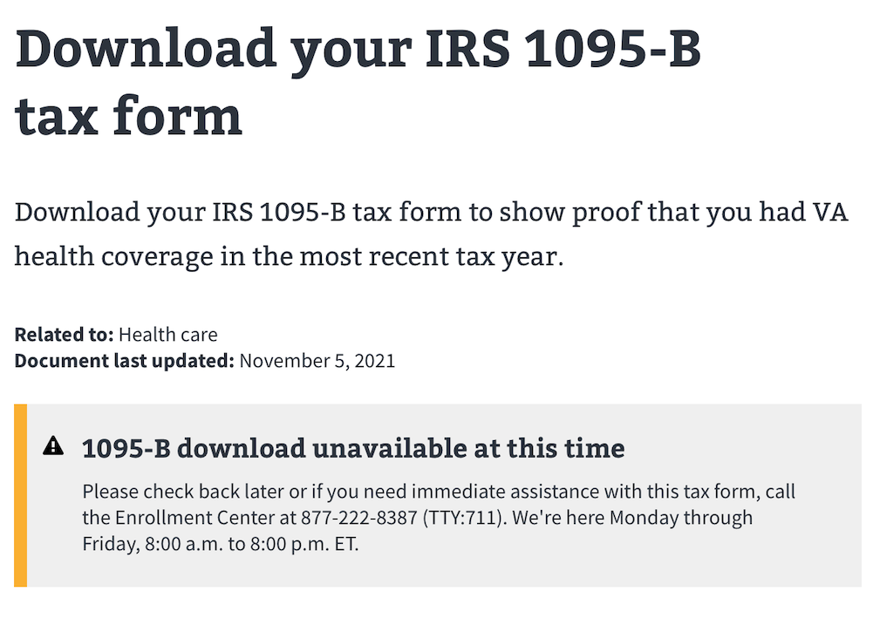
B
User experience when the feature toggle is off
User Story: Build feature toggle for widget
We’ve got a PR for this change (needs to be approved and merged)
Design
08-23 Sprint 9 Demo
1095-B
13

Slide 14

C
Business owner brief - August 16, 2022
User Story: Business owner engagement
User Story: PM team to monitor for HEC approval of 1095-B MVP and opt-in designs
Purpose
Executive level brief for approval to launch 1095-B MVP
Socialize incident response
Discuss 1095-B opt-in to digital delivery next steps
Artifacts
Brief deck
Business case request for ES work required for opt-in
Brief
08-23 Sprint 9 Demo
1095-B
14

Slide 15
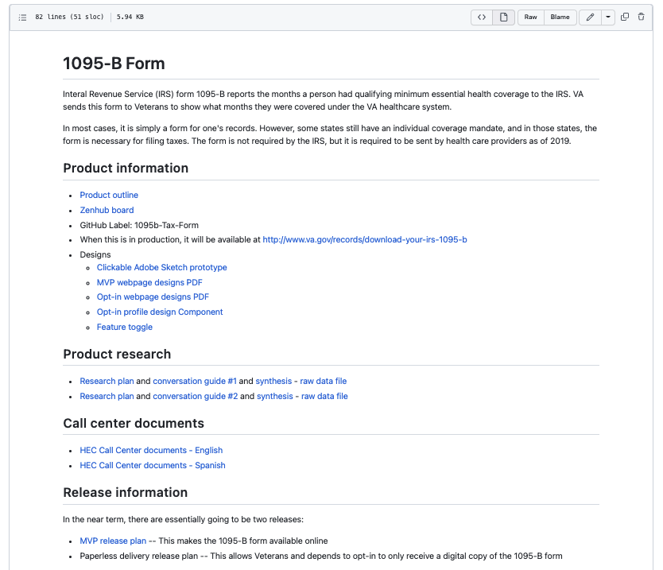
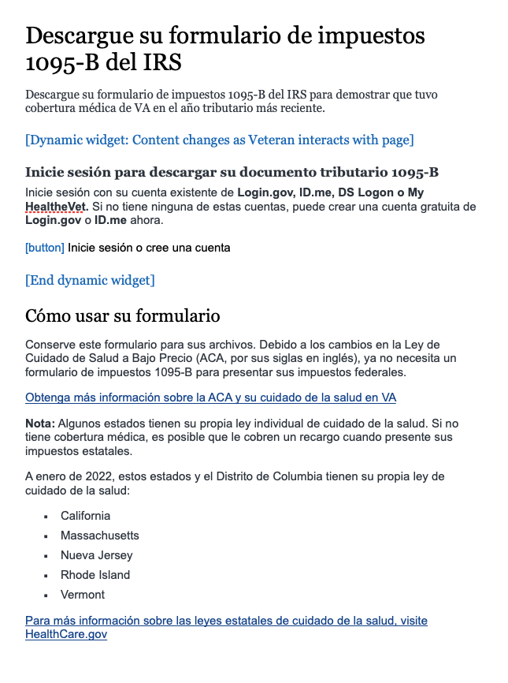
D
Other updates
User Story: Collaboration cycle: Analytics Implementation
User Story: PM to f/u w/ Sitewide on HEC document translations
User Story: Draft - Document everything for transition of ownership of 1095-B
User Story: Draft - Moderated UAT conversation guide
User Story: Draft - Moderated UAT research plan
Updating radio button type
*Previous version is now deprecated
Spanish translation of HEC call center documents is back from the State Department
Coordinating with Analytics team to get 1095-B instrumented
Draft research plan for UAT
README and technical documentation for 1095-B is constantly updated in detail for transition to next team
SPA Translations; 1095-B read.me
08-23 Sprint 9 Demo
1095-N
15

Slide 16
Steps to 1095-B MVP launch (1 of 2)
Delayed
In progress
Completed
Not started
E
STEP | OWNED BY | ACTION NEEDED | DATE ENTERED | STATUS | NOTES
Contact center review | 1095-B / Contact center | Artifacts to be quality reviewed by Contact center staff | 22-Jul-22 |  | Closed 8/9/22
Analytics implementation | 1095-B / Analytics | Ticket completion and alignment on KPIs | 27-Jul-22 |  | Awaiting dashboard URL; Analytics sprint starts 1Sep22
Privacy, security, and infrastructure review | 1095-B / Security | Ticket completion and all 9 artifacts attached | 27-Jul-22 |  | Closed 8/11/22
 |  | Product outline | 27-Jul-22 |  | Completed 8/4/22
 |  | Release plan | 27-Jul-22 |  | Completed 8/5/22
 |  | Incident response plan / Playbook | 27-Jul-22 |  | Completed 8/9/22
 |  | Architecture diagram | 27-Jul-22 |  | Completed 8/9/22
 |  | Sequencing diagram | 27-Jul-22 |  | Completed 8/9/22
 |  | Data Flow diagram | 27-Jul-22 |  | Completed 8/8/22
 |  | API Endpoint document | 27-Jul-22 |  | Complete by Tues EOD
 |  | Accessibility file | 27-Jul-22 |  | 5 out of 6 test complete; Axe scan is done in dark launch
Resolve transport script / bucket | 1095-B / HEC | Reopen bucket ticket (GitHub #38079) and ensure Joshua (HEC) has access to appropriate buckets to fill transport script | 9-Aug-22 |  | Completed 8/20/22
08-23 Sprint 9 Demo
1095-B

Slide 17
Steps to 1095-B MVP launch (2 of 2)
Delayed
In progress
Completed
Not started
STEP | OWNED BY | ACTION NEEDED | DATE ENTERED | STATUS | NOTES
Scenario testing of loaded product | 1095-B | Complete scenario testing and PR’s for loaded product to include updating any deprecated design components and other staging tests | 17-Aug -22 |  | Sprint 9/10
Staging review | 1095-B / Collab Cycle teams | Complete product ticket with documented previous collab cycle steps initiated and under async review. Platform notified of status 4 business days prior to meeting in order to review all artifacts and post recommendations. Meeting to be held 30th August 2022 @ 11:30 AM. | 13-Jul -22 |  | Sprint 10; 30-Aug-22
In staging testing | 1095-B/Public websites | Build method to conduct usability testing of react widget on static Drupal page with authentication dependent data. Commence internal testing with VFS Veterans with PIV and VA.gov Veteran credentials | 21-Aug-22 |  | Sprint 9/10; Public-Websites initiated build 23-Aug-22
Research plan - Moderated UAT | 1095-B / Perigean / VA Research | Create research plan, and conversation guide for moderated UAT for approval of VA research team and submission to Perigean for recruitment. | 5-Aug-22 |  | Sprint 9/10
Moderated UAT | 1095-B | Moderated usability testing with Veteran’s recruited through Perigean. TBD. Record findings in product release plan | 5-Aug-22 |  | Sprint 10+
Staged Rollout | 1095-B | Roll out of product on VA.gov will be staged and include feature toggle. Canary test 25% TBD; Stage B 50% TBD. Incident response plan will be followed if product fails to perform as desired. | 5-Aug-22 |  | TBD; blocked by VA-PO
Go Live | 1095-B | Official go-live target TBD | 7-Aug-22 |  | TBD; blocked by VA-PO
08-23 Sprint 9 Demo
1095-B

Slide 18
Path to task order close-out
SPRINT 9 DEMO
08-23 Sprint 9 Demo

Slide 19
CEDAR TO1 closeout (1 of 3) v1
Delayed
In progress
Completed
Not started
STEP | OWNED BY / TURNOVER TO | ACTION NEEDED | COMPLETED | STATUS | NOTES
Completion of HH research #1 w/ caregivers | HealthHub / Mikki | Amend research plan to initiate final unmoderated testing of remaining caregivers | 9-Aug-22
 |  | Submit research plan for recruitment by Perigean | 9-Aug-22
 |  | Put research plan, guide, data sets, and synthesis in GitHub HH repo turnover read.me. |  |  | Sprint 9/10
Completion of HH research #2 – Moderated tree test | HealthHub / Mikki | Submit research #2 to Mikki for feedback and approval | 8-Aug-22
 |  | Submit research #2 to oCTO for approval and recruitment (Must request Perigean note taker service) | 9-Aug-22
 |  | Conduct pilot testing | 11-Aug-22 |  | Sprint 9
 |  | Conduct moderated testing of trees |  |  | Sprint 9/10
 |  | Synthesis research findings and make recommendation if able |  |  | Sprint 10
 |  | Put research plan, guide, data sets, Perigean notes, synthesis, recommendations (if able) in GitHub HH repo turnover read.me. |  |  | Sprint 10
HH Turnover document | HealthHub / Mikki & Tracey | Turnover document (include links to discovery, all research documents, and recommended next steps. Place in Health Hub turnover read.me file. Send link to Mikki Northius & Tracey Mulrooney for review / edits |  |  | Draft sprint 9, due sprint 10
08-23 Sprint 9 Demo
TO1 Closeout

Slide 20
CEDAR TO1 closeout (2 of 3)
Delayed
In progress
Completed
Not started
STEP | OWNED BY / TURNOVER TO | ACTION NEEDED | COMPLETED | STATUS | NOTES
Analytics | 1095-B | Implement analytics in pre-staging and provide implementation monitoring status / turnover |  |  | Initiated sprint 8, prioritized with Platform analytics for Sept 1st
Research plan - Moderated UAT | 1095-B | Create research plan, and conversation guide for moderated UAT for approval of VA research team and submission to Perigean for recruitment. Record findings in release plan and staging accessibility ticket |  |  | Sprint 9/10
Moderated UAT | 1095-B | Complete moderated UAT TBD and document in assessment in product release plan |  |  | Sprint 10+
Staged rollout | 1095-B | Roll out of product on VA.gov will be staged and include feature toggle. Canary test 25% TBD; Stage B 50% TBD. Incident response plan will be followed if product fails to perform as desired. |  |  | Sprint 10+
HEC Spanish translated documents | 1095-B | Monitor status of 1095-B translation of HEC documents from State Department via Sitewide (Randi Hecht) and turn over to business owner (Tarsha Tremble) | 22-Aug-22
1095-B Turnover document (MVP and Opt-in) | 1095-B / Tracey & Health Apps team | Turnover document (include links to discovery, research documents, collaboration cycle product documents, Opt-in build plan, and recommended next steps with owners timelines. Place in GitHub read.me turnover document. Send link to VA-PO for review. |  |  | Draft sprint 9, due sprint 10
08-23 Sprint 9 Demo
TO1 Closeout

Slide 21
CEDAR TO1 closeout (3 of 3)
Delayed
In progress
Completed
Not started
STEP | OWNED BY / TURNOVER TO | ACTION NEEDED | COMPLETED | STATUS | NOTES
HEC requirements ticket | 1095-B / HEC | Provide business requirements for Tarsha (HEC) to submit ticket |  |  | Sprint 9
HEC written approval | HEC / 1095-B | Obtain and upload into product repo written approval of MVP design and content prior to launch (Due 21-Aug-22 to avoid shifting timeline) |  |  | Sprint 9/10 [Launch blocking dependency]. Communication between HEC and VA-PO
Turnover meeting | 1095-B / Health Apps | Tracey will arrange a 30-minute meeting with Health Apps team to review product 9 and a 60-minute meeting to review turnover read.me document and plan for next steps. Additionally, team will be available for asynchronous questions after initial meeting. |  |  | Sprint 10
08-23 Sprint 9 Demo
TO1 Closeout

Slide 22
Next steps for new team v2 (1 of 2)
Delayed
In progress
Completed
Not started
STEP | OWNED BY | ACTION NEEDED | COMPLETED | STATUS | NOTES
Post launch review (1week) | Health Apps | Complete post launch assessment in product release plan. Due 12-Sep-22
Post launch review (1 month) | Health Apps | Complete post launch assessment in product release plan. Due 5-Oct-22
Opt-in legal review | Health Apps MyVA OGC | Put together a legal package (product outline, static page opt-in designs / content, MyVA opt-in designs / content) for review by OGC. Coordinated through HEC (Tarsha). |  |  | [Opt-in launch blocking dependency] Raun, Eric L. (OGC) <Eric.Raun@va.gov> Case# GCL 158655 Lawyer POC who reviewed MVP OGCHealthCareLawGroupAttorneys@va.gov General legal assistance email request line
Wayfinding | Health Apps Sitewide | Submit intake ticket with sitewide with IA document, user path, and crosslinks to wayfinding to create wayfinding to 1095-B page. Takes 1-2 Sprints.
Build 1095-B paperless preference on Veterans VA.gov profile page | MyVA | On the MyVA Veteran Profile preferences page, the user can opt-in to receive the 1095-B form digitally. This will start the data flow to stop the physical form from being mailed out to the user during tax season. It’ll take about 8 sprints to do this work (3.5 months) The team started 8/2/2022 |  |  | MyVA Veteran profile opt-in designs complete 16-Aug-22. Additional work placed on hold by VA-PO 18-AUG-22
Storage of Veteran preferences for audit trail | VA Profile/ MyVA | This preference is consumed and stored. We’ll also need an audit trail for when the preference is changed, in case VA gets audited by the IRS. Work in coord. w/ MyVA.
08-23 Sprint 9 Demo
Next Steps

Slide 23
Next steps for new team v2 (2 of 2)
Delayed
In progress
Completed
Not started
STEP | OWNED BY | ACTION NEEDED | COMPLETED | STATUS | NOTES
Data push to ES | VA Profile | Interaction with enrollment services to synchronize the preference data. This will be implemented as a push notification fired on a per-veteran-per-profile change basis.
Data synch with VA Profile | HEC- ES | Change a field in the 1095-B print file, synchronizing the preference data. Business requirements submitted 8/11/22. Requested delivery of work December 1, 2022. |  |  | HEC ES work deprioritized to Mar 2023
Link 1095-B page to Veterans profile | Health Apps Sitewide MyVA | Submit intake ticket with sitewide to build onto 1095-B Drupal page the opt-in design element (alert link) since opt-in element is the same in unauth and auth environment. opt-in designs
Communications plan | Health Apps | Build a communications plan for opt-in to advertise service, tax season notification for those who have opt-in. Sample veteran communication used by eBenefits. Draft notifications here
Multi-year build | Health Apps | Tax forms are commonly available for multiple years due to audits and delayed filing, offering a multi-year retrieval service could be a future enhancement
Removal of feature toggle code | Health Apps | Submit ticket to remove code for feature toggle on react widget after opt-in is built and functioning for 1 entire tax season
08-23 Sprint 9 Demo
Timing for opt-in collaboration / build to be monitored by New 1095-B team (aka Health Apps)
Next Steps

Slide 24
Sprint Deliverables
SPRINT 9 DEMO
08-23 Sprint 9 Demo

Slide 25
Sprint 9 Deliverables (1 of 2)
EPIC | STORY | ESTIMATE | ASSIGNED | OUTPUT | REVIEWED W/ VA-PO | SPRINT TEAM GOAL COMPLETED?
Research | #44721 Discuss recruitment with Perigean | 1 | Thomas | N/A | 8/10/2022 | ✓
Research | #44719 Conduct pilot test of research #2 | 5 | Carolyn Carl | Notes | 8/11/22 | ✓
Research | #44961 Begin moderated research #2 | 13 | Carl Carolyn Deb Thomas | Research notes - Perigean Observer notes | 8/15/2022 | ✓
Research | #45553 Draft synthesis modeling for moderated research #2 | 8 | Deb | Model | 8/23/2022 | ✓
1095-B | #45285 Build feature toggle for widget | 5 | Teagan Carl Thomas | Toggle design | 8/23/2022 | ✓
1095-B | #45555 Ensure ES writes script to load 1095-B data file | 1 | Teagan | N/A | 8/23/2022 | ✓
1095-B | #45522 Discovery into analytics dashboard for MVP | 5 | Shashank Teagan | N/A | 8/23/2022 | ✓
1095-B | #45326 Draft – Moderated UAT conversation guide | 3 | Shashank | Research plan, draft | 8/23/2022 | ✓
1095-B | #45325 Draft – Moderated UAT research plan | 5 | Shashank | Research plan, draft | 8/23/2022 | ✓
1095-B | #45843 Radio button change | 2 | Teagan | N/A | 8/23/2022 | ✓
08-23 Sprint 9 Demo
Sprint 9 Deliverables

Slide 26
Sprint 9 Deliverables (2 of 2)
EPIC | STORY | ESTIMATE | ASSIGNED | OUTPUT | REVIEWED W/ VA-PO | SPRINT TEAM GOAL COMPLETED?
1095-B | #44401 Collaboration cycle: Staging review | 0 | Tami Shashank Carl | Ticket | 8/23/2022 | ✓
1095-B | #44810 Collaboration cycle: Analytics implementation or QA support | 0 | Teagan Shashank | Ticket | 8/23/2022 | ✓
1095-B | #44811 Collaboration cycle: Staging review accessibility checklist | 3 | Dan | Ticket | 8/23/2022 | ✓
1095-B | #44812 Collaboration cycle: Privacy, security and infrastructure review | 5 | Shashank Munish | Ticket | 8/23/2022 | ✓
1095-B | #45501 Business owner engagement | 3 | Munish Carl Tami | Presentation deck | 8/23/2022 | ✓
1095-B | #45532 PM team to monitor for HEC approval of 1095-B MVP and Opt-in designs | 0 | Tami | N/A | 8/23/2022 | ✓
1095-B | #42158 PM team to f/u w/sitewide on HEC documents (Opt-in) being translated into Spanish | 0 | Tami | HEC SPA docs | 8/23/2022 | ✓
Opt-in | #45530 Draft HEC Business case requirements [Opt-in] ticket for HEC Business Owner | 2 | Tami | ES change request | 8/23/2022 | ✓
Opt-in | #45104 Write requirements with owners for every step of 1095-B post MVP Opt-in build | 2 | Shashank Tami | Slide #22-23 in deck | 8/23/2022 | ✓
Trans | #45108 Draft – Document everything for transition of ownership for Health Hub | 5 | Thomas | Read me | 8/23/2022 | ✓
Trans | #45504 Draft – Document everything for transition of ownership of 1095-B | 8 | Shashank Tami | Read me | 8/23/2022 | ✓
PMO | #45584 Platform orientation [Deb Dennis] | 5 | C | Ticket | 8/23/2022 | ✓
PMO | #45883 Platform off-boarding [Munish Sikka] | 0 | C | Ticket | 8/23/2022 | ✓
08-23 Sprint 9 Demo
Sprint 9 Deliverables

Slide 27
Preview of Sprint 10
SPRINT DEMO
08-23 Sprint 9 Demo

Slide 28
Sprint 10 will focus on
 | Next sprint demo: Sep 6th
HEALTH HUB
*Stories subject to change during sprint planning
Complete remaining interviews
Provide synthesis
Finalize transition documentation
1095-B
Continue testing with full data set
Continue staging review collaboration
Prepare for MVP launch
Transition work to new team
08-23 Sprint 9 Demo
Preview of Sprint 10

Slide 29
Appendix
SPRINT 9 DEMO
08-23 Sprint 9 Demo

Slide 30
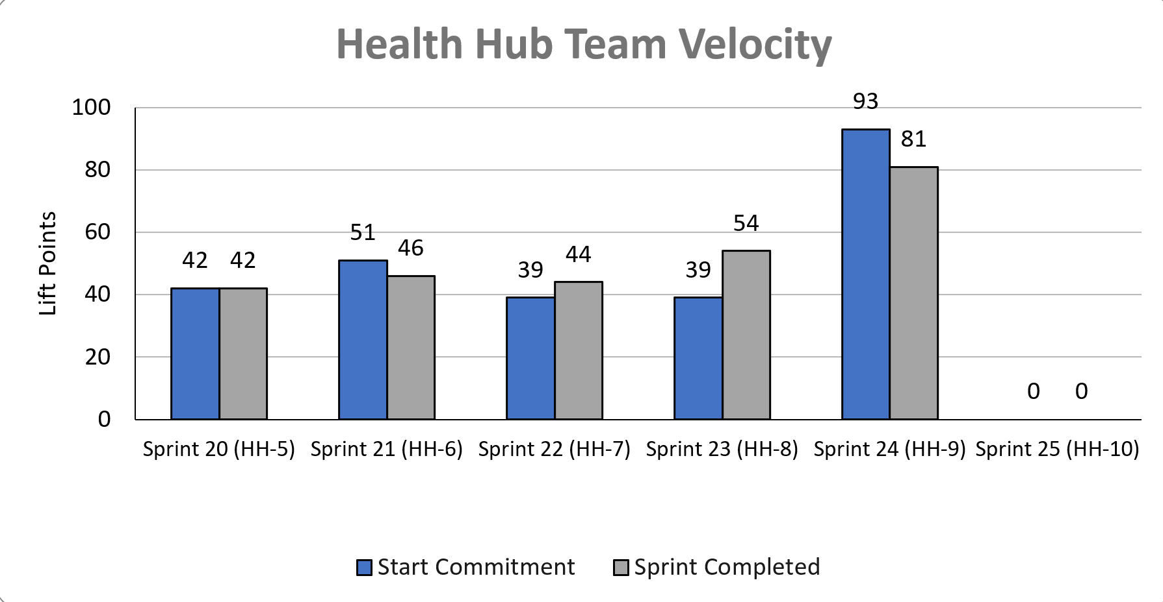
Health Hub Team velocity
 | Velocity details Velocity estimated in story points, using Fibonacci Velocity in Sprint 9 accounted for 10 team members, with a loss of 1 member at mid-sprint 81 total story points were completed; Team committed to 93 story points at beginning of the sprint. 2 Stories were deferred to the following sprint related to staging review delay (8 points). 2 Stories were blocked due to staging readiness and prioritization of analytics build by Platform analytics (6 points). 1 Story was added (2 points) related to radio button change in VA design scheme
08-23 Sprint 9 Demo
Appendix
30

Slide 31
Project risks and mitigation strategies (1 of 2)
RISK AND IMPACT | MITIGATION STRATEGY | DATE |  | STATUS | NOTES
 |  | ENTERED | CLOSED
IRS stakeholder is outside of VA ecosystem. Building without guidance or legal review regarding compliance with IRS regulation could result in risk. | Conduct research on available information surrounding current IRS 1095-B tax form regulations. Seek legal review through VA resources as directed by VA-PO and Business Owner | 1/20/22 | 2/11/22 |  | VA Business Owner clarified that IRS review is not needed
Team had previously confirmed with Business Owner that legal review was not needed. Business Owner clarified that legal review would be needed as of March 2nd | Business Owner is seeking a POC with the Office of General Counsel to understand what is needed and potential launch impact | 3/2/22 | 5/17/22 |  | Launch blocker
Data requires storage in a S3 bucket that the enrollment system can have access to in production; process to create the staging and production bucket does not have a clear timeline. Without the S3 bucket in prod with enrollment system access, product cannot be built in prod | Daily follow-ups with Jesse House and Mike Chelan (infrastructure team) | 3/1/22 | 3/24/22 |  | S3 bucket now in place. Risk resolved.
Business owner raised User Acceptance Testing should be done with HEC Call Center | Requested Business Owner to schedule UAT with required individuals for mid-March and book as early as possible | 3/2/22 | 3/25/22 |  | Business owner confirmed that UAT can be done through Collaboration Cycle and does not have to be done with HEC team
Feedback from Content and IA Review has taken over a week to come in; feedback is changing our proposal for the H1 and delaying confirmation of where the 1095-B landing page should live, which in turn delays our ability to complete the front end (top nav and side nav bars) | Design team pushing on IA team to confirm final answer of where 1095-B landing page should live and what the H1 header title should be | 03/04/22 | 3/8/22 |  | URL confirmed 3/7 EOD; IA review now closed
08-23 Sprint 9 Demo

Slide 32
Project risks and mitigation strategies (2 of 2)
RISK AND IMPACT | MITIGATION STRATEGY | DATE |  | STATUS | NOTES
 |  | ENTERED | CLOSED
Designs were approved as part of Midpoint Review. Afterwards, Sitewide Content stated they would need to build our front end in Drupal and change our designs, impacting our in-flight build. | Design team met with Sitewide Content to align on redesigned front end. Tech working with Sitewide Content to send over our dynamic widget to be pulled into their static front end. Sitewide Content now owns the front end build. | 3/10/22 | 4/12/22 |  | Launch date dependent on Sitewide Content ability to launch front end
HH Tree Test design held up due to new information from Meg, Danielle and Mikki. | VA and MO team could work in collaborative sessions so that work is not duplicated, and we can arrive at a test design that works by the end of Sprint 3 | 5/16/22 | 5/26/22 |  | Awaiting version of ‘manage’ tree that we can incorporate into research trees in order to move forward with research plan
HEC Legal review required for 1095-B Opt-in | Opt-in is being built by VA Profile team | 3/2/22 | 6/11/22 |  | Post-MVP enhancement blocker
08-23 Sprint 9 Demo

Slide 34
A
Lorem
User Story: Lorem
User Story: Lorem
User Story: Lorem
User Story: Lorem
User Story: Lorem
Lorem
Lorem
Lorem
Lorem
Lorem
Lorem
Lorem
Lorem
Lorem
Lorem
Lorem
Lorem
Lorem
Lorem
Lorem
Lorem
Lorem
Lorem
Lorem
Lorem
Lorem
Lorem
Lorem
Lorem
Link
08-09 Sprint 8 Demo
Lorem
34

Slide 35
Sprint 9 Deliverables (3 of_)
Keep for added stories: Add stories, tickets, dates, deliverables w/ links
EPIC | STORY | ESTIMATE | ASSIGNED | OUTPUT | REVIEWED W/ VA-PO | SPRINT TEAM GOAL COMPLETED?
R | #40000 Lorem | 0 | C | Lorem Lorem Lorem Lorem Lorem | 8/23/2022 | ✓
R | #40000 Lorem | 0 | C | Lorem Lorem Lorem Lorem Lorem | 8/23/2022 | ✓
R | #40000 Lorem | 0 | C | Lorem Lorem Lorem Lorem Lorem | 8/23/2022 | ✓
R | #40000 Lorem | 0 | C | Lorem Lorem Lorem Lorem Lorem | 8/23/2022 | ✓
R | #40000 Lorem | 0 | C | Lorem Lorem Lorem Lorem Lorem | 8/23/2022 | ✓
R | #40000 Lorem | 0 | C | Lorem Lorem Lorem Lorem Lorem | 8/23/2022 | ✓
R | #40000 Lorem | 0 | C | Lorem Lorem Lorem Lorem Lorem | 8/23/2022 | ✓
R | #40000 Lorem | 0 | C | Lorem Lorem Lorem Lorem Lorem | 8/23/2022 | ✓
R | #40000 Lorem | 0 | C | Lorem Lorem Lorem Lorem Lorem | 8/23/2022 | ✓
R | #40000 Lorem | 0 | C | Lorem Lorem Lorem Lorem Lorem | 7/12/2022 | ✓
08-23 Sprint 9 Demo
Sprint 9 Deliverables

Slide 36
1095-B MVP Launch and Close-Out
Task | Notes | Status (Not started, In Progress, Completed) | Expected Completion Date/Sprint #
Finalize materials for Spanish translations | 8/3/2022 documents transmitted to state Department by Sitewide | In progress | Requested by 9/7/2022
Determine metrics and implement tracking
Release 1095B without opt-in
Write requirements with owners for every step of the 1095B release with opt-in; Ensure every team understands the requirements and has provided a time for delivery
Build the remaining work outlined in the 1095B doc.
Document everything for transition of ownership; Past work and designs, future requirements, roadmap and next steps for opt-in release, release/change management required for each tax year
08-09 Sprint 8 Demo
1095-B Blockers

Slide 37
Health Hub Moderated Studies and Close-Out
Task | Notes | Status (Not started, In Progress, Completed) | Expected Completion Date/Sprint #
Finalize based on oCTO feedback and submit the research plan and conversation guide for the moderated study of both tree tests |  | In progress
Conduct moderated study and deliver recordings and notes |  | Not started
Synthesize moderated study with recommendations, depending on when research is conducted. |  | Not started
Provide full data set from tree tests for further analysis |  | Completed?
Document everything for transition of ownership |  | Not started?
08-09 Sprint 8 Demo
1095-B Blockers

Slide 38
A
Lorem
User Story: Lorem
User Story: Lorem
User Story: Lorem
User Story: Lorem
User Story: Lorem
Lorem
Lorem
Lorem
Lorem
Lorem
Lorem
Lorem
Link
07-12 Sprint 6 Demo
Lorem
38

Slide 39
A
Lorem
User Story: Lorem
User Story: Lorem
User Story: Lorem
User Story: Lorem
User Story: Lorem
Lorem
Lorem
Lorem
Lorem
Lorem
Lorem
Lorem
Link
07-12 Sprint 6 Demo
Lorem
39

Slide 40
Sprint 9 Deliverables (_ of_)
EPIC | STORY | ESTIMATE | ASSIGNED | OUTPUT | REVIEWED W/ VA-PO | SPRINT TEAM GOAL COMPLETED?
R | #40000 Lorem | 0 | C | Lorem Lorem Lorem Lorem Lorem | 7/12/2022 | ✓
R | #40000 Lorem | 0 | C | Lorem Lorem Lorem Lorem Lorem | 7/12/2022 | ✓
R | #40000 Lorem | 0 | C | Lorem Lorem Lorem Lorem Lorem | 7/12/2022 | ✓
R | #40000 Lorem | 0 | C | Lorem Lorem Lorem Lorem Lorem | 7/12/2022 | ✓
R | #40000 Lorem | 0 | C | Lorem Lorem Lorem Lorem Lorem | 7/12/2022 | ✓
R | #40000 Lorem | 0 | C | Lorem Lorem Lorem Lorem Lorem | 7/12/2022 | ✓
R | #40000 Lorem | 0 | C | Lorem Lorem Lorem Lorem Lorem | 7/12/2022 | ✓
R | #40000 Lorem | 0 | C | Lorem Lorem Lorem Lorem Lorem | 7/12/2022 | ✓
R | #40000 Lorem | 0 | C | Lorem Lorem Lorem Lorem Lorem | 7/12/2022 | ✓
R | #40000 Lorem | 0 | C | Lorem Lorem Lorem Lorem Lorem | 7/12/2022 | ✓
Sprint 9 Deliverables

Slide 41
1095-B Remaining actions, with external dependencies
Munish Slide
ITEM | WORK STREAM | ACTION NEEDED | TARGET COMPLETE DATE | PREREQUISITE
Launch | Product & Tech | Work with tech to create a vets-website release | Aug | Hybrid MVP build for accessibility
UAT | Product & Tech | Follow Collaboration Cycle guidelines for UAT Identify Veterans within VA to conduct UAT, send access, and follow up to ensure testing complete | Aug | MVP dark launch
1095-B Opt-in | Product | Follow up with HEC and Profiles team to ensure 1095-B opt-in is done Follow up with Notifications team to ensure related SMS & e-mail notification flow is optimal Internal testing of text version of 1095-B Update draft communications and announcement plans, based on when opt-in will be launched | Oct | Ongoing collaboration meetings to align responsibilities and timeline
Notification Triggers | Design & Tech | Notification letters approved by legal Build triggers for opt-in, opt-out, annual update | Sep / Oct | Legal review
Legal Review | Product | Work with Tarsha to complete legal review for Opt-In | Oct / Nov | POC name from Tarsha. Legal package submitted by team and VA profile
Post MVP Launch Check- In | Product | Complete Collaboration Cycle milestone to KPIs post launch | TBD (One month after launch and announcement) | Product launched in prod
Links from VA.gov pages to 1095-B (wayfinding) | Product & Design | Work with IA team to have other identified pages within VA.gov (e.g., ACA page) link to the 1095-B page Work with IA team to have 1095-B page added to navigation and be found in VA.gov search | Aug / Sep | Product launched in prod; aligned on comm plan with Tarsha, Tracey
1095-B update strategy | Product | Align on who will own 1095-B long term, including updating the PDF template each year | Sept | Product complete and launched in production
Communications to announce launch | Product & Design | Work with Tarsha and HEC team to refine drafted communications and align on plan and timeline to announce 1095-B launch to Veterans Work with VA Notify team to build and launch communications on their platform | Aug | Product launched in prod; aligned on communication plan with Tarsha/Tracey
08-09 Sprint 8 Demo
1095-B Remaining actions

